Slide 1
Sirius Project Status
2017-12-13

Slide 2
Sirius project plan and status
Project preparation is start from 2016/6 and done by 2016/12 and official start on 2016/12.
Build up whole chip Database, integrate all digital/Analog IP into SOC system
Build up whole chip SOC RTL simulation environment to verify design function.
Build up whole chip Veloce emulate environment to verify design function and user case, develop software firmware and system solution.
Release Bronze/Silver/Final RTL & NETLIST & SDC.
Project finished final run stage with VSI (3rd party design service company), build whole chip floor plan, sub-block floor-plan, clean SDC/netlist/UPF issue, run place&route timing check, sign off.
Real final tape out on TSMC is starting on 2017/11/15 and get wafer out by 2018/1/11.
Now still design EK board/ test load board schematic for chip bring up.

Slide 3
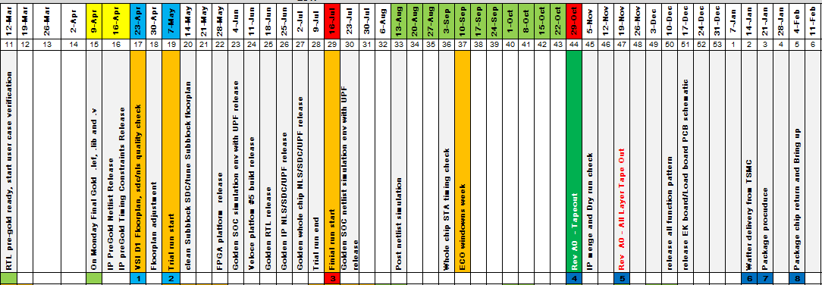
Sirius project schedule

Slide 4
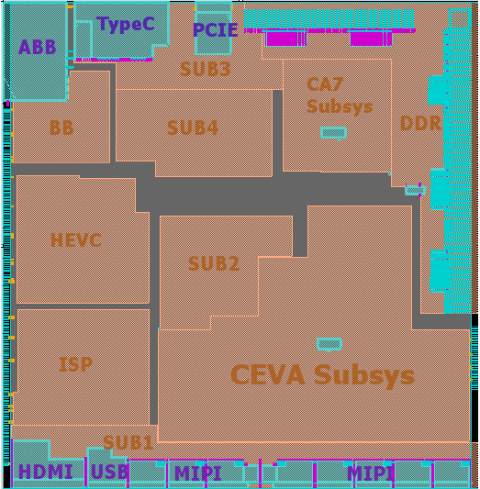
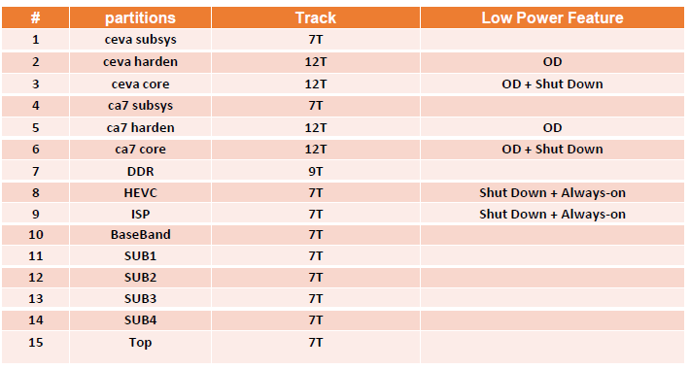
Process: TSMC 28HPC 1P8M+UT-ALRDL_5x2Z Chip size is 9450x1000
Design floor plan

Slide 5
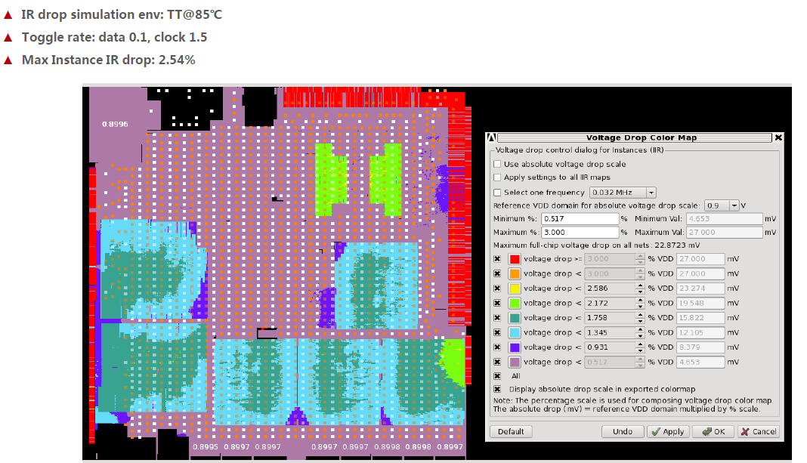
IR Drop

Slide 6
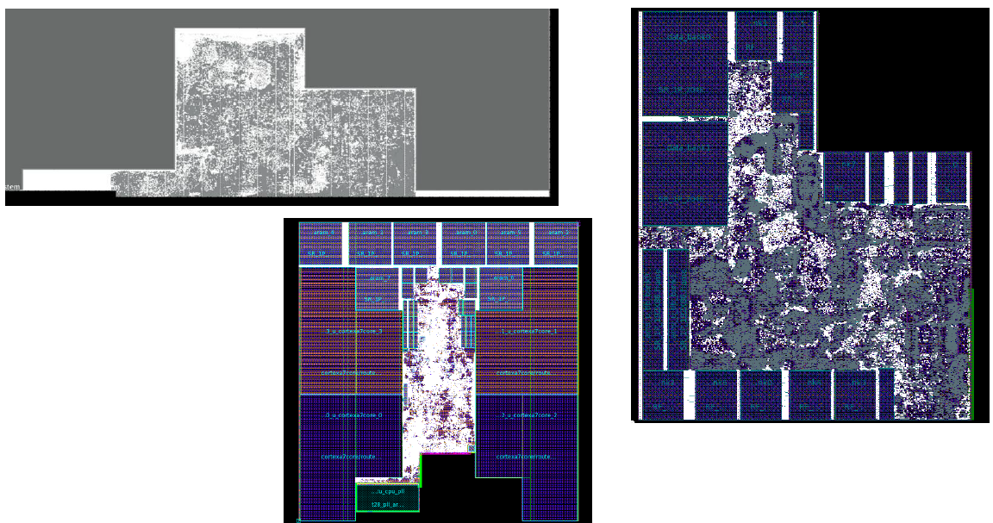
CPU Design diagram

Slide 7
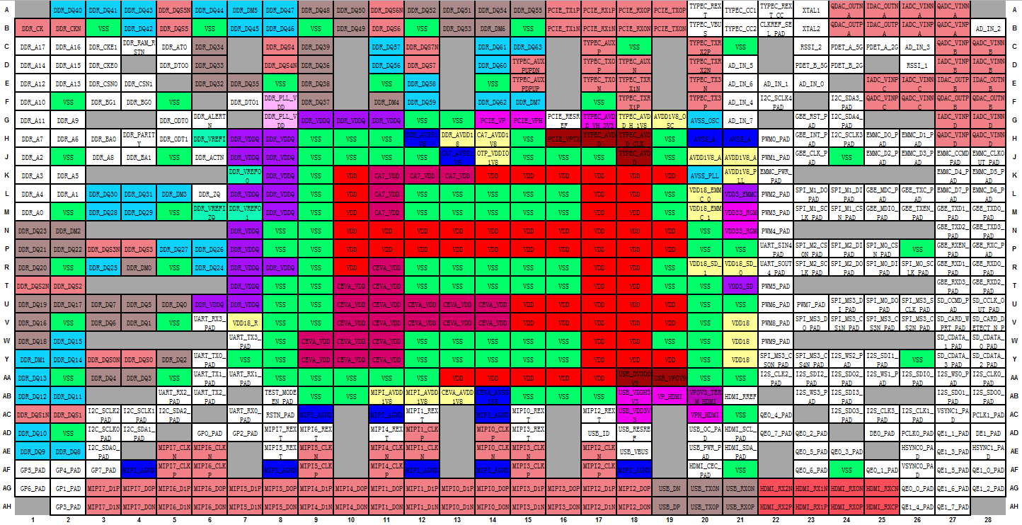
Ball map

Slide 8
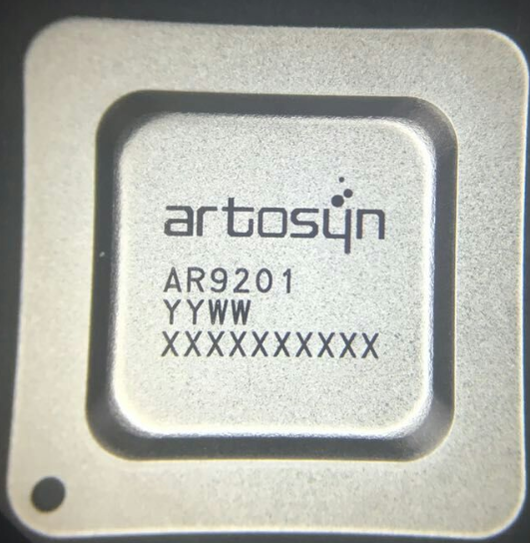
Chip Marking

Slide 9
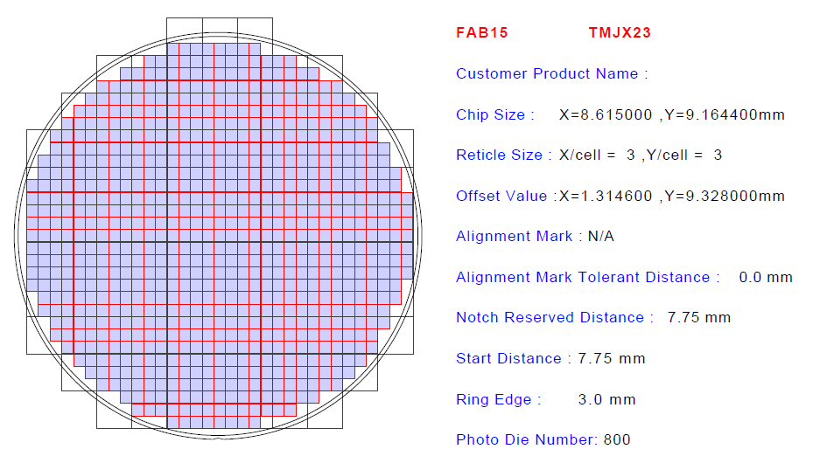
Photo die map

